Slide 1

Job Market Analysis
A Power BI-Based Insight Report
Name : Manish Karmankar
Team ID : PTID-CDA-MAR-25-410

Slide 2
Introduction
Objectives
To analyze job market trends in the data science field using real-world job posting data.
To identify the states and cities with the highest number of job openings.
To compare salary ranges (minimum, maximum, and average) across different states and job titles.
To find the most in-demand job titles and their associated average salaries.
To discover top industries and companies hiring for data science roles.
To analyze skill requirements for various job roles and understand the most frequently requested technical skills.
To explore the relationship between education levels and average salary in data science-related jobs.
To provide actionable insights and recommendations for job seekers and employers based on visual data analysis.

Slide 3
Dataset Overview
Source: Aggregated from various online job platforms (as per project brief)
Size: 742 rows × 42 features
Key Features:
Job Title: Role offered (e.g., Data Scientist, ML Engineer)
Salary Estimate: Ranges including min, max, average salary
Company Info: Includes name, rating, size, type, revenue, etc.
Skills Required: Binary flags for Python, Excel, AWS, etc.
Education: Degree requirements (Bachelor, Master, Ph.D.)
Location: State and city-wise job listings

Slide 4
Methodology
Tools Used:
Power BI for visualization and dashboard creation
Python (Pandas) for data cleaning and preprocessing
Key Steps Followed:
Data Cleaning – Removed duplicates and standardized column formats
Missing Value Treatment – (-1) values with blanks to handle missing information Replaced all
Feature Engineering – Extracted salary metrics, job seniority, and skill flags
Data Visualization – Created interactive charts to derive actionable insights

Slide 5
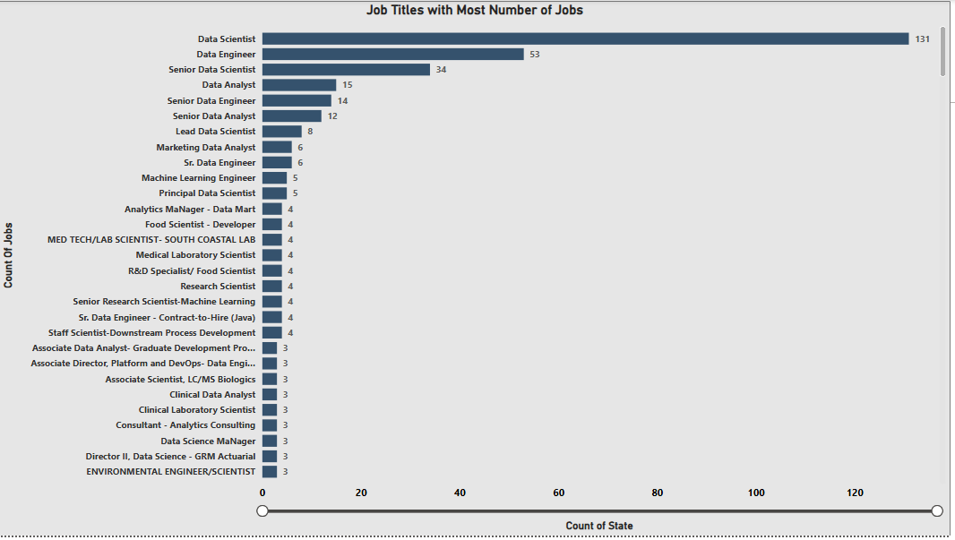
Data Visualization & Key Insights
States with Most Jobs
Key Insight: California, Texas, and New York have the highest job openings, making them prime targets for job seekers.
Use: Horizontal/vertical bar chart or map.

Slide 6
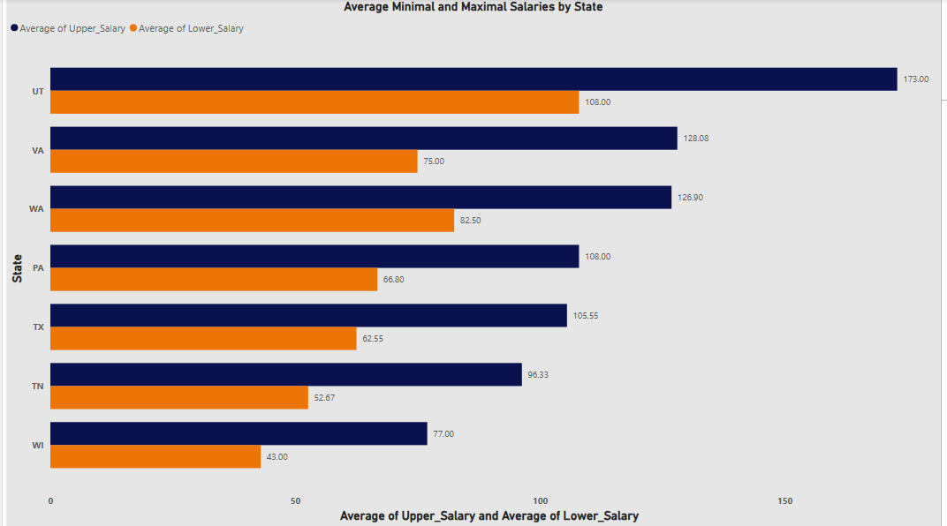
Average Minimal and Maximal Salaries by State
Key Insight
Utah (UT) offers the highest average upper salary at $173K, making it the most lucrative state among those listed.
Virginia (VA) and Washington (WA) follow with strong upper salaries of around $128K and $127K, respectively.
There's a significant gap between upper and lower salary bounds in several states (e.g., UT and PA), indicating variability in role levels or negotiation flexibility.
Wisconsin (WI) has the lowest salary range, with lower salaries averaging $43K and upper salaries around $77K, showing a more conservative pay scale.
Texas (TX) and Tennessee (TN) offer mid-range salaries but still remain competitive, with upper bounds above $95K.

Slide 7
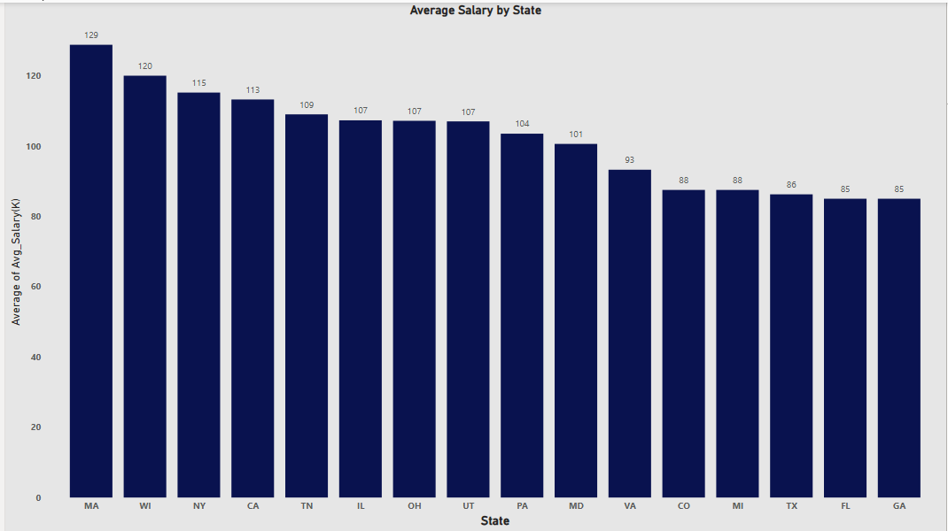
Salary by State
Key Insight: Average salaries peak in California and New York, while Midwest states show moderate pay scales with fewer outliers.
Use: Box plot or line chart

Slide 8
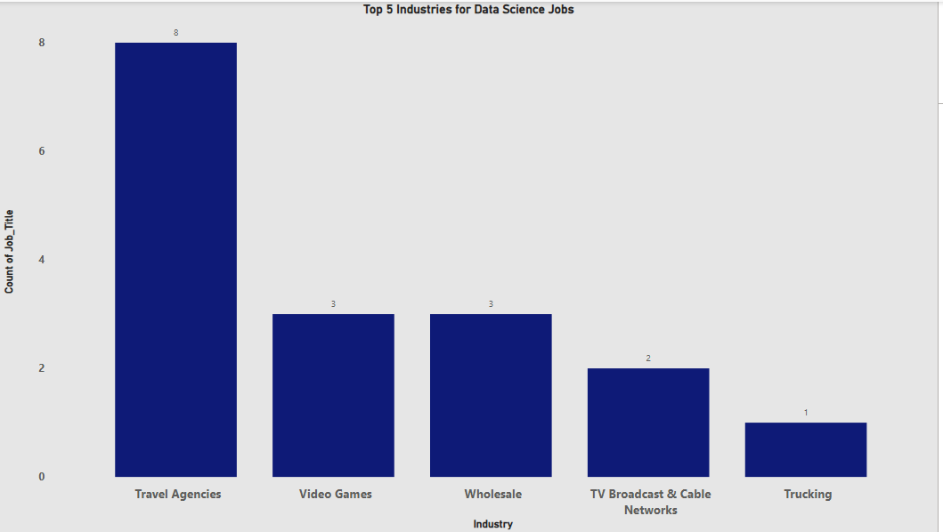
Top 5 Industries with Job Postings
Key Insight: The IT, Consulting, and Healthcare industries dominate in data job postings, suggesting strong sectoral demand.
Use: Horizontal bar chart

Slide 9
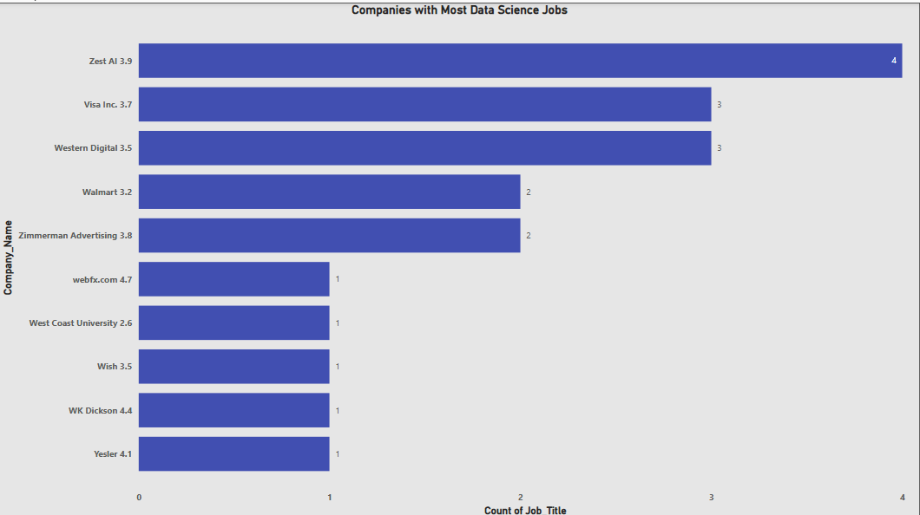
Companies with Most Data Science Jobs
Key Insight
Top Hiring Companies:
Zest AI leads with 4 data science job postings.
Visa Inc. and Western Digital follow closely with 3 jobs each.
Company Ratings:
Some high-rating companies like webfx.com (4.7) and WK Dickson (4.4) have only 1 job posting, indicating fewer openings despite good ratings.
Companies with moderate ratings (e.g., Zest AI 3.9, Visa Inc. 3.7) are offering more jobs.
Diversity in Hiring:
There's a long tail of companies (e.g., Wish, Yesler, West Coast University) offering only one data science role each.

Slide 10
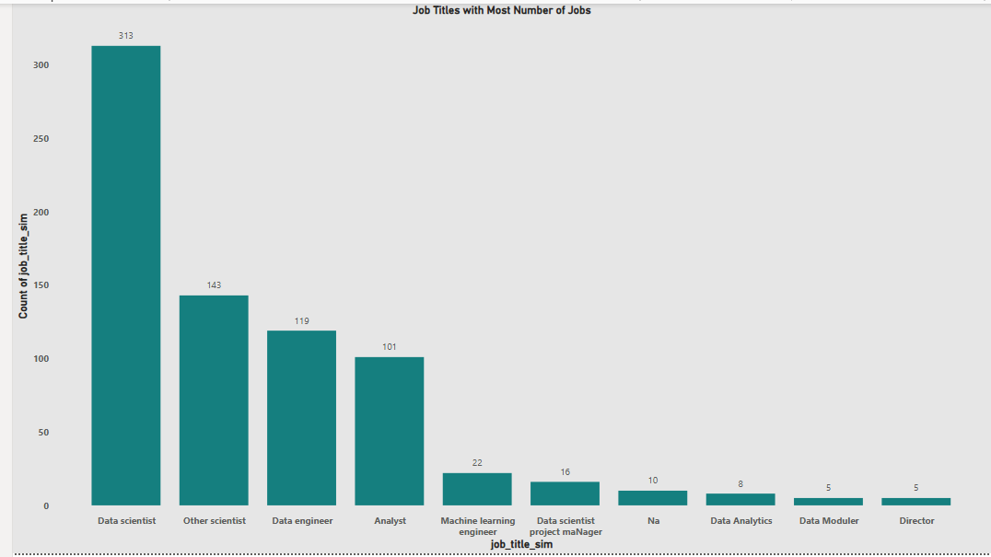
Job Titles with Most Number of Jobs
Key Insight:
"Data Scientist" is the most sought-after job title by a large margin.
A small number of companies are hiring more actively, while most are offering just one role.
There's no clear correlation between company rating and the number of job postings.

Slide 11
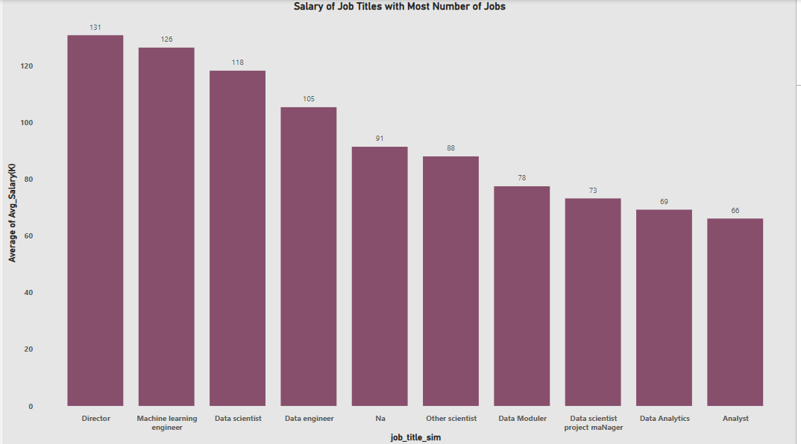
Salary of job title with most number of jobs
Key Insight:
Directors earn the highest average salary at $131K, followed by Machine Learning Engineers ($126K) and Data Scientists ($118K).
Analysts earn the lowest among the top job titles with an average of $66K.
There's a clear salary hierarchy based on job seniority and technical specialization — roles with more advanced or strategic functions tend to offer higher pay.

Slide 12
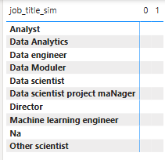
Cleaned Job Titles (job title sim)
Key Insight:
This table shows the standardized or cleaned versions of job titles.
Anomalies such as "Na" and inconsistent casing (e.g., "Data scientist project manager") suggest that some data still needs further cleaning for better analysis.

Slide 13
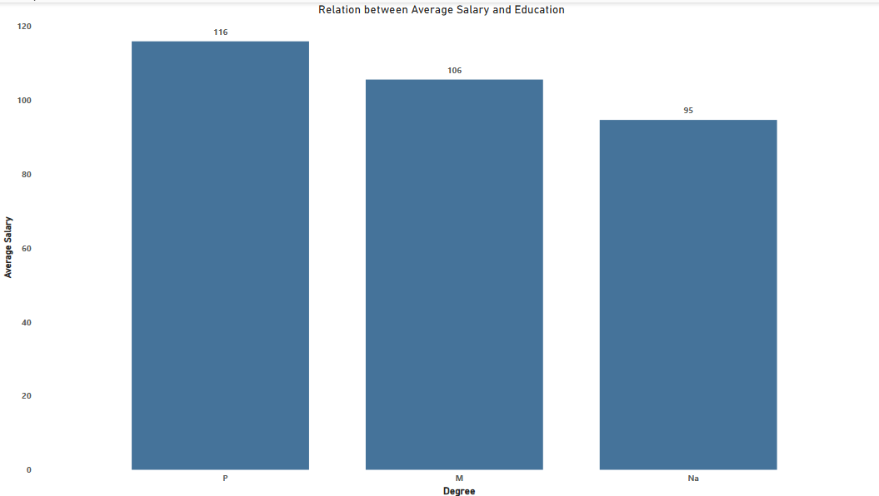
Relation between Average Salary and Education Level
Key Insight :
Individuals with a Ph.D. (P) earn the most on average ($116K), followed by those with a Master's (M) at $106K, and those with unspecified or no degree data ("Na") at $95K.
There is a positive correlation between education level and average salary, indicating that higher degrees tend to lead to higher compensation.

Slide 14
Interpretations of Insights
States with the Most Job Openings
What it shows: Displays which U.S. states have the highest number of data science job postings.
Why it’s important: Indicates where job opportunities are concentrated geographically.
How it helps: Job seekers can target high-opportunity states; companies can analyze regional competition for talent.
Average Minimum and Maximum Salaries by State
What it shows: Compares salary ranges (min and max) offered in different states.
Why it’s important: Highlights regional salary differences and cost-of-living implications.
How it helps: Job seekers can prioritize states offering higher compensation; employers can adjust offers to stay competitive.
Top 5 Industries Hiring for Data Science
What it shows: Lists industries with the highest number of data science job postings.
Why it’s important: Reveals which sectors are actively investing in analytics and AI roles.
How it helps: Students and professionals can align skillsets with industry demand; companies in less active industries can reevaluate hiring strategy.

Slide 15
Companies with the Most Job Openings
What it shows: Highlights companies with the largest number of active postings.
Why it’s important: Identifies top employers and potential recruiters.
How it helps: Job seekers can focus applications on high-hiring firms; employers can benchmark against top competitors.
Most Common Job Titles
What it shows: Frequency of specific job roles like “Data Scientist,” “ML Engineer,” etc.
Why it’s important: Gives clarity on how roles are titled in the industry.
How it helps: Job seekers can optimize resumes with high-frequency titles; educators can align course names and training programs accordingly.
Skills Required by Job Title
What it shows: Skill requirements (e.g., Python, Excel, SQL) mapped to job roles.
Why it’s important: Identifies core and emerging technical skills.
How it helps: Learners can prioritize skill development; employers can better define job specs.

Slide 16
Education vs. Average Salary
What it shows: Relationship between educational qualifications (e.g., Master's, Ph.D.) and salary levels.
Why it’s important: Evaluates if higher education correlates with better pay.
How it helps: Job seekers can assess the ROI of pursuing higher degrees; companies can tailor role requirements realistically.

Slide 17
Recommendations & Suggestions
For Job Seekers:
Master In-Demand Skills Based on the analysis, the most frequently required skills across job postings include Python, AWS, Excel, SQL, and Machine Learning. 🔹 Recommendation: Focus on building a strong foundation in these tools and technologies through projects, certifications, or internships. 🔹 Why: These skills increase your eligibility for a wider range of job roles and make you stand out in applicant tracking systems (ATS).
Target the Right Locations & Industries The data clearly shows that certain states—such as California, New York, and Texas—have a higher number of data science-related job postings. Similarly, industries like Technology, Finance, Healthcare, and Consulting dominate hiring. 🔹 Recommendation: Apply strategically by focusing on high-opportunity regions and fast-growing industries. 🔹 Why: This improves your chances of faster placement and higher salary offers.

Slide 18
For Employers & Recruiters:
Benchmark Salaries Against Competitors Many top companies offer highly competitive salaries. If your salary packages are below the state or industry average, you may lose out on talent. 🔹 Suggestion: Conduct regular salary benchmarking to ensure your offers remain attractive. 🔹 Why: Competitive compensation helps attract skilled candidates and reduces hiring time.
Align Job Requirements with Skill Trends The job market shows a consistent demand for core skills such as Python, AWS, SQL, and communication. However, some companies list outdated or overly generic skill sets. 🔹 Suggestion: Refine job descriptions to match current skill demands and make them more role-specific. 🔹 Why: This helps in attracting the right candidates and reducing mismatches during interviews.
Consider Location Flexibility With most jobs concentrated in urban states, companies located in less active regions may face challenges in hiring. 🔹 Suggestion: Explore hybrid or remote work policies to widen the talent pool. 🔹 Why: This makes your job openings accessible to more qualified applicants beyond your region.

Slide 19
Conclusion
Major Trends Identified:
States like California, New York, and Texas are leading in job opportunities for data science roles.
Python, SQL, AWS, and Excel are the most in-demand skills across job titles.
Industries such as Technology, Finance, and Healthcare show the highest hiring rates.
There's a noticeable correlation between higher education (Master’s/Ph.D.) and better salary offers.
Value of This Analysis:
This project provided me with a deeper understanding of the real-world job market trends using data visualization and interpretation.
It helped me improve my skills in Power BI, data preprocessing, and deriving insights that are actually useful for both job seekers and recruiters.
The insights can serve as a strategic guide for candidates looking to position themselves competitively, and for companies to optimize their hiring strategies.
Possible Extensions of the Project:
Expand the dataset to include job postings over time to analyze trends by year or quarter.
Integrate LinkedIn job market data for real-time analysis.
Use predictive analytics or machine learning to forecast demand for certain skills or job titles.
Build a dashboard-based recommendation tool for job seekers based on their skills and preferred locations.

